Slide 1
Modeling

Slide 2
Requirements model
Requirements model must achieve three primary objectives:
(1) to describe what the customer requires,
(2) to establish a basis for the creation of a software design,
(3) to define a set of requirements that can be validated once the software is built

Slide 3
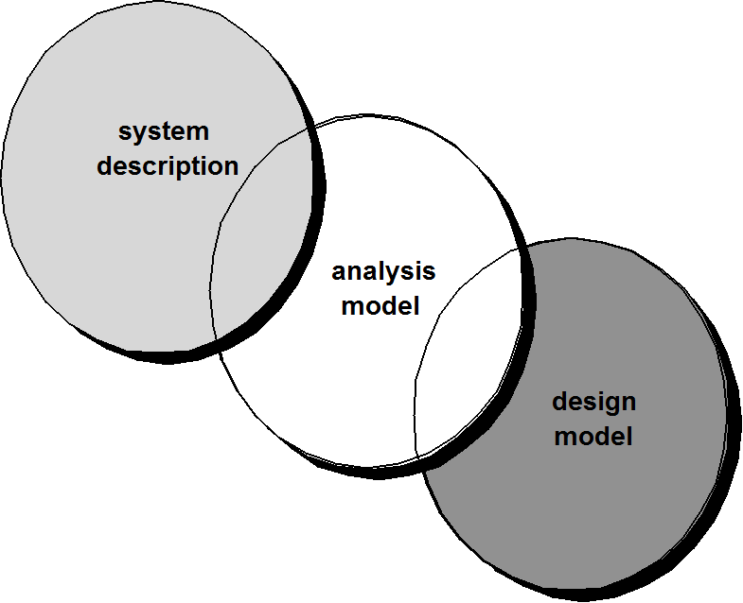
A Bridge

Slide 4
Analysis model
One view of requirements modeling, called structured analysis, considers data and the processes that transform the data as separate entities.
Data objects are modeled in a way that defines their attributes and relationships.
Processes that manipulate data objects are modeled in a manner that shows how they transform data as data objects flow through the system.
A second approach to analysis modeled, called object-oriented analysis, focuses on
the definition of classes and
the manner in which they collaborate with one another to effect customer requirements.

Slide 5
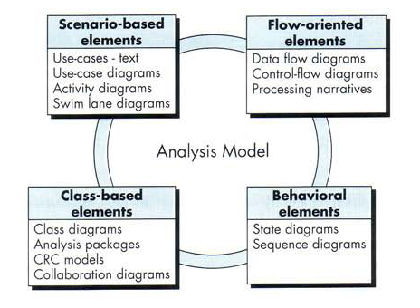
Elements of Analysis model

Slide 6
Elements of Analysis model
Each element of the requirements model presents the problem from a different point of view.
Scenario-based elements depict how the user interacts with the system and the specific sequence of activities that occur as the software is used.
Class-based elements model the objects that the system will manipulate, the operations that will be applied to the objects to effect the manipulation, relationships (some hierarchical) between the objects, and the collaborations that occur between the classes that are defined.

Slide 7
Elements of Analysis model
Behavioral elements depict how external events change the state of the system or the classes that reside within it.
Finally, flow-oriented elements represent the system as an information transform, depicting how data objects are transformed as they flow through various system functions.

Slide 8
Scenario-Based Modeling
Use-Case
Activity Diagram
Swim-Lane Diagram

Slide 9
Use-Cases
“[Use-cases] are simply an aid to defining what exists outside the system (actors) and what should be performed by the system (use-cases).”
actors represent roles people or devices play as the system functions
users can play a number of different roles for a given scenario
A use case captures the interactions that occur between producers and consumers of information and
the system itself.

Slide 10
Developing a Use-Case
What are the main tasks or functions that are performed by the actor?
What system information will the actor acquire, produce or change?
Will the actor have to inform the system about changes in the external environment?
What information does the actor desire from the system?
Does the actor wish to be informed about unexpected changes?

Slide 11
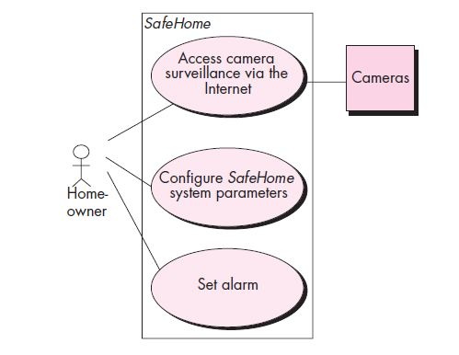
Use-Case Diagram

Slide 12
Activity Diagram
The UML activity diagram supplements the use case by providing a graphical representation of the flow of interaction within a specific scenario.
Similar to the flowchart, an activity diagram uses rounded rectangles to imply a specific system function, arrows to represent flow through the system, decision diamonds to depict a branching decision (each arrow emanating from the diamond is labeled), and solid horizontal lines to indicate that parallel activities are occurring.

Slide 13
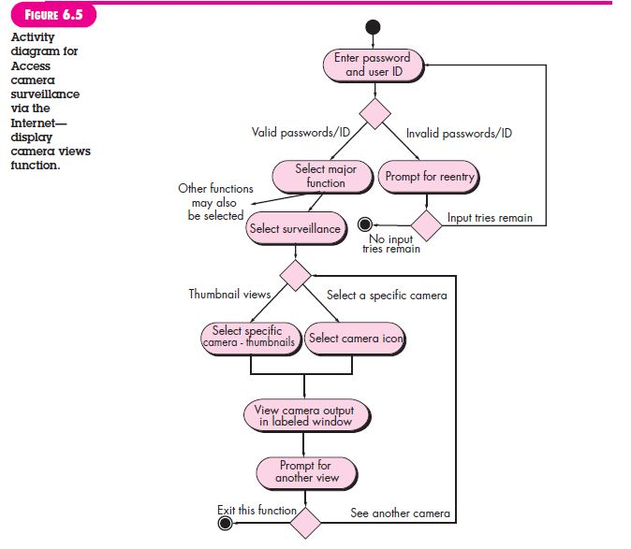
Activity Diagram

Slide 14
Swim lane Diagrams
Variation of activity diagram.
Allows the modeler to represent the flow of activities described by the use-case and at the same time indicate which actor (if there are multiple actors involved in a specific use-case) or analysis class has responsibility for the action described by an activity rectangle.

Slide 15
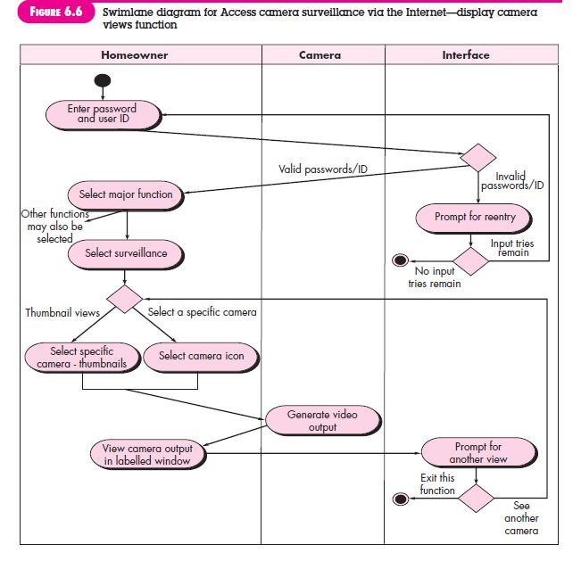

Slide 16
Flow-Oriented Modeling
The DFD takes an input-process-output view of a system.
That is, data objects flow into the software, are transformed by processing elements, and resultant data objects flow out of the software.
Data objects are represented by labeled arrows, and transformations are represented by circles (also called bubbles).

Slide 17
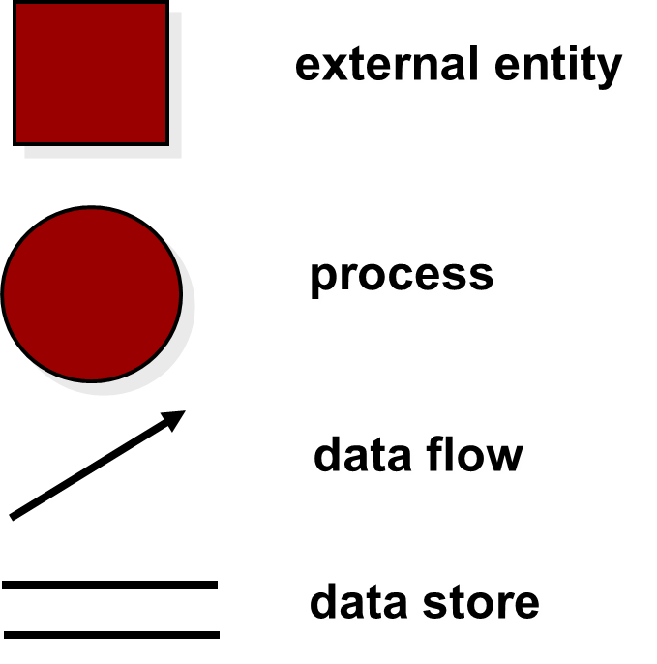
Flow Modeling Notation

Slide 18
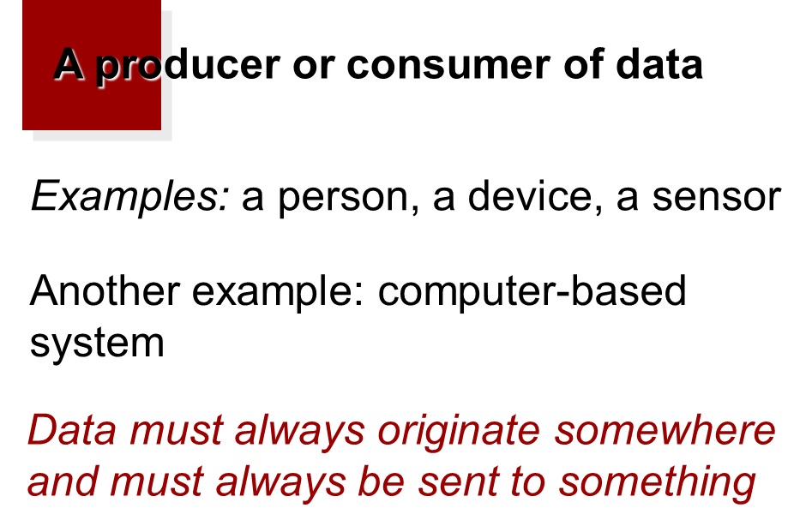
External Entity

Slide 19
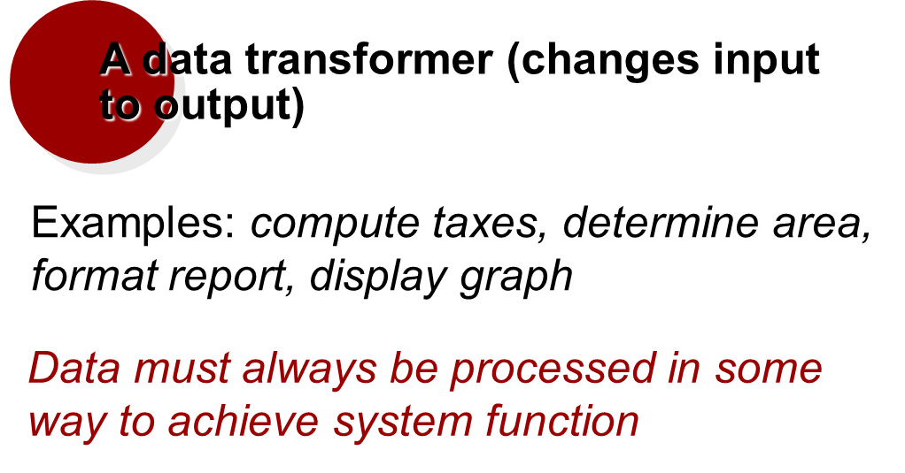
Process

Slide 20
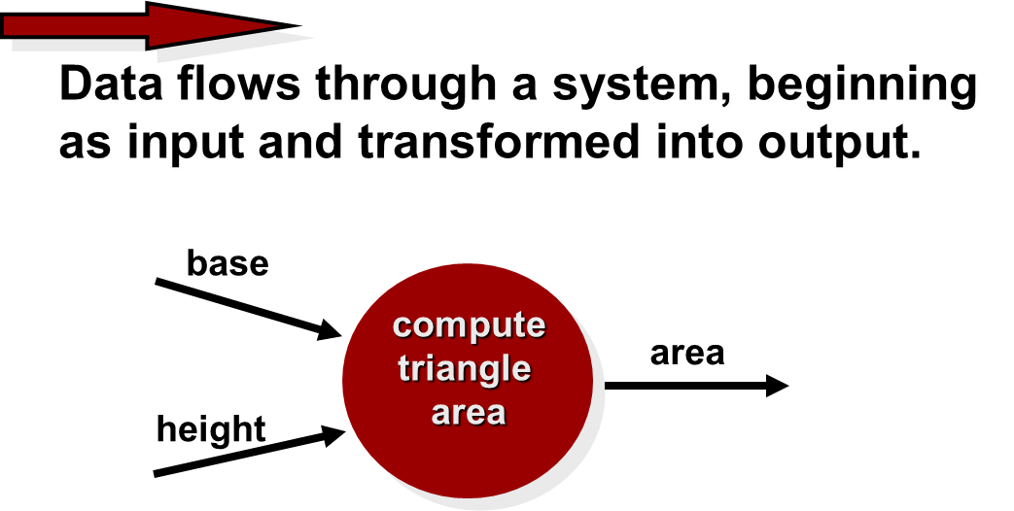
Data Flow

Slide 21
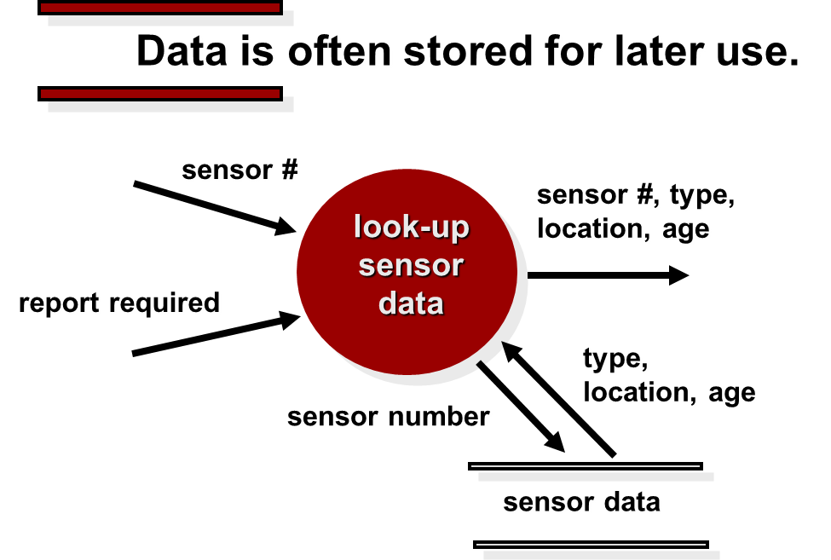
Data Stores

Slide 22
Data Flow Diagramming: Guidelines
All icons must be labeled with meaningful names.
The DFD evolves through a number of levels of detail.
Always begin with a context level diagram (also called level 0).
Refinement should begin by isolating candidate processes, data objects, and data stores to be represented at the next level;
Always show external entities at level 0.
Do not represent procedural logic.

Slide 23
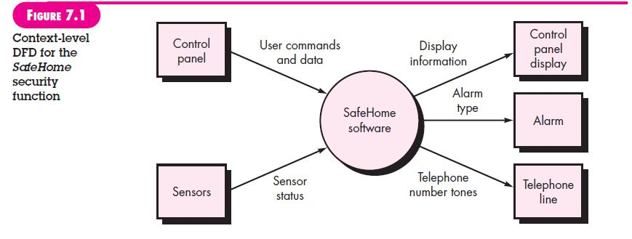
Level-0 DFD

Slide 24
The Data Flow Hierarchy
a
b
x
P
y
level 0
a
c
p2
f
p1
p4
b
d
5
p3
e
g
level 1

Slide 25
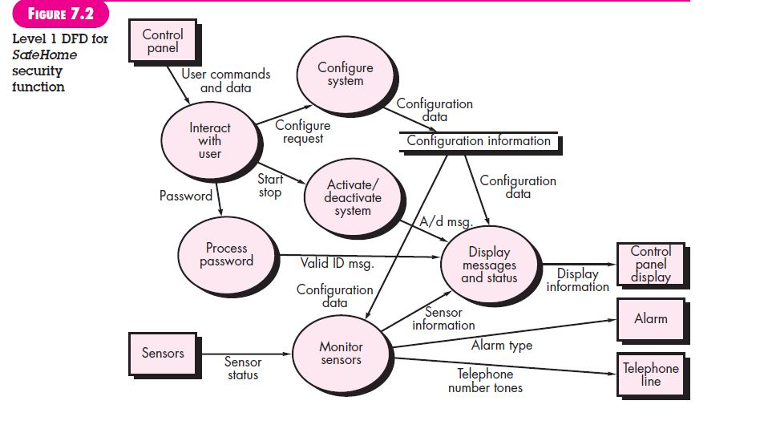
Level 1 DFD

Slide 26
Behavioral Modeling
The behavioral model indicates how software will respond to external events or stimuli.
Make a list of the different states of a system (How does the system behave?)
Indicate how the system makes a transition from one state to another (How does the system change state?)
indicate event
indicate action

Slide 27
Behavioral Modeling
To create the model, the analyst must perform the following steps:
Evaluate all use-cases to fully understand the sequence of interaction within the system.
Identify events that drive the interaction sequence and understand how these events relate to specific objects.
Create a sequence for each use-case.
Build a state diagram for the system.
Review the behavioral model to verify accuracy and consistency.

Slide 28
State diagrams
State diagram represents the active states for each class of the system and the events (triggers) that cause changes between these active states.

Slide 29
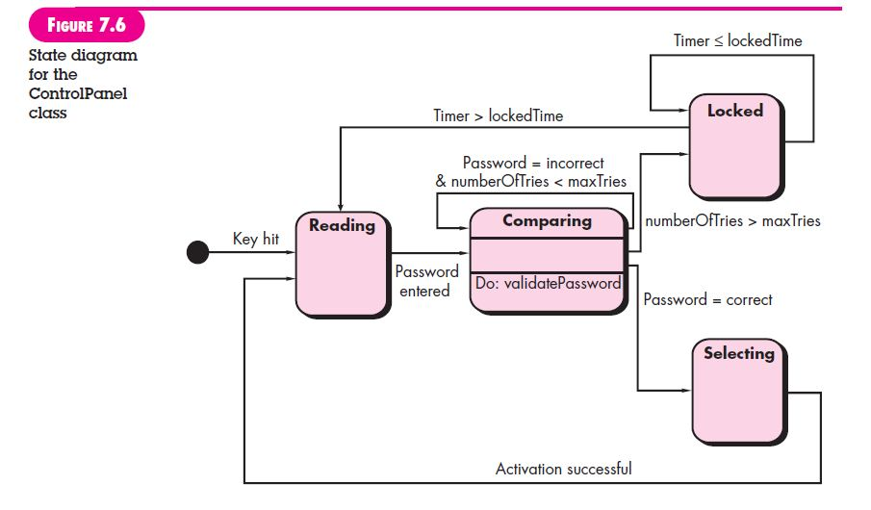
State Diagram for the ControlPanel Class

